Slide 2
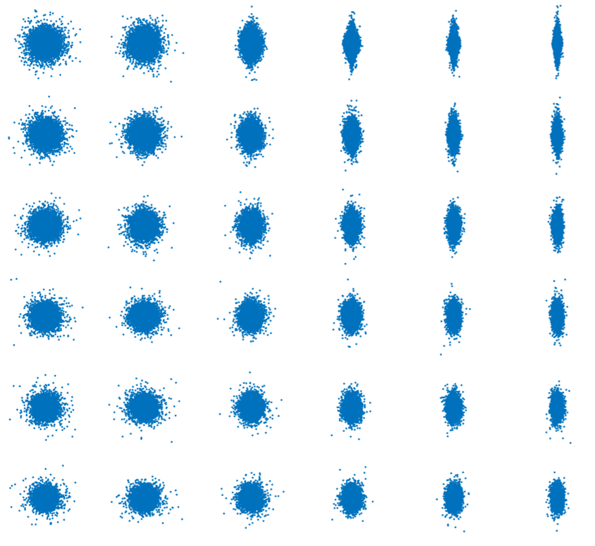
RESULT FIGURE 1
magnetic intencity
0
100
300
500
700
900
0
0.2
0.4
scattering intencity
magnetic field direction
0.6
0.8
1.0

Slide 3
RESULT FIGURE 2
magnetic field direction
1
3
5
7
9
11
initial velocity
(magnetic intencity = 500, scattering intensity = 0.5)

Slide 4
